Slide 1
ATOMIC DESIGN

Slide 2
BACKGROUND
Atomic design is a division of UI/UX design that provides a clear methodology for a design process that has often been sporadic.
Atomic design gives the ability to traverse from abstract to concrete designs. It allows systems to promote consistency, and scalability.

Slide 3
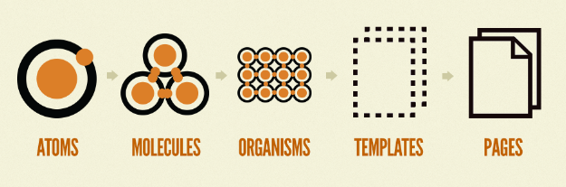
ATOMIC DESIGN
Atomic design is a methodology for designing user interfaces by breaking it down into atoms, molecules, organisms, templates, and pages.

Slide 4
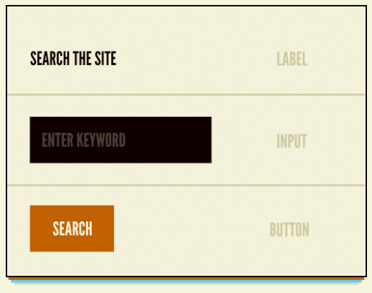
ATOMS
Atoms are the most basic building blocks of matter.
They include HTML tags, form labels, and buttons.
They can also include color palettes, fonts, and animations.

Slide 5
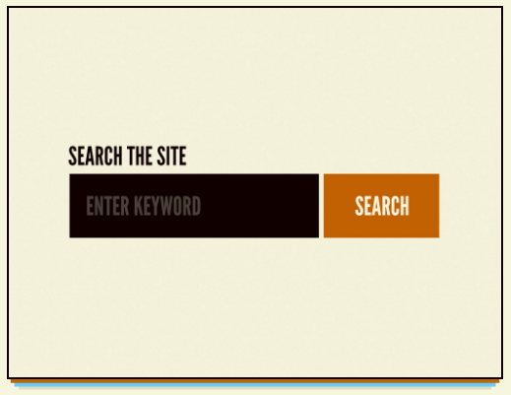
MOLECULES
Molecules are formed when atoms are combined together.
Labels, inputs, and buttons are no useful by themselves, but combined together they create a useful component.

Slide 6
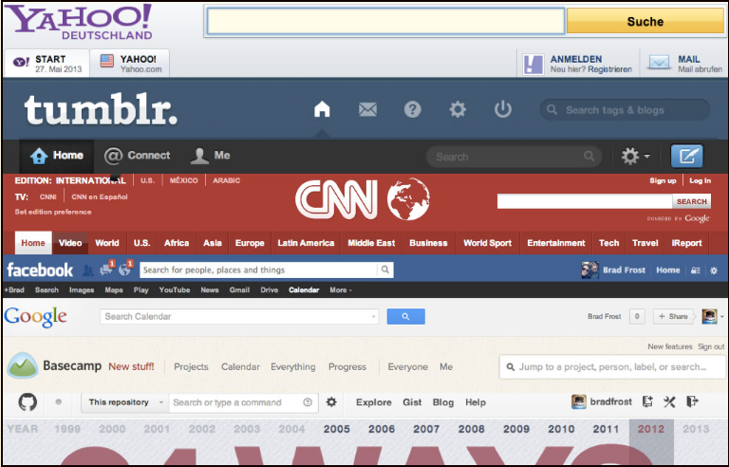
ORGANISMS
Organisms are groups of molecules that are joined together to form a complex section of an interface, like a banner bar.
Users are not always interested in molecules, but organisms start to give an app shape.
Organisms can consist of logos, navigation bars, search forms, or social media channels.

Slide 7
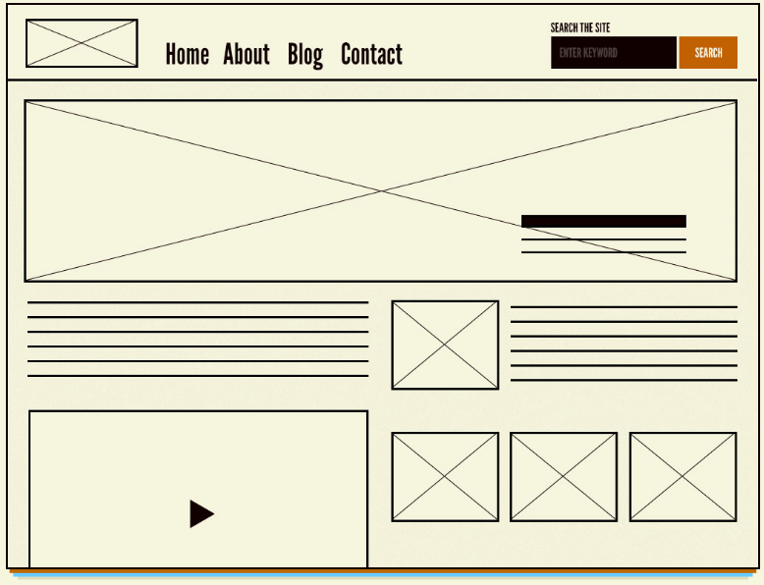
TEMPLATES
Templates consist of groups of organisms that are stitched together to form pages.
This is where the design of the page comes together.

Slide 8

PAGES
Pages are instances of templates.
Placeholder content is replaced with content to give accurate depiction of what the user will see.

Slide 9
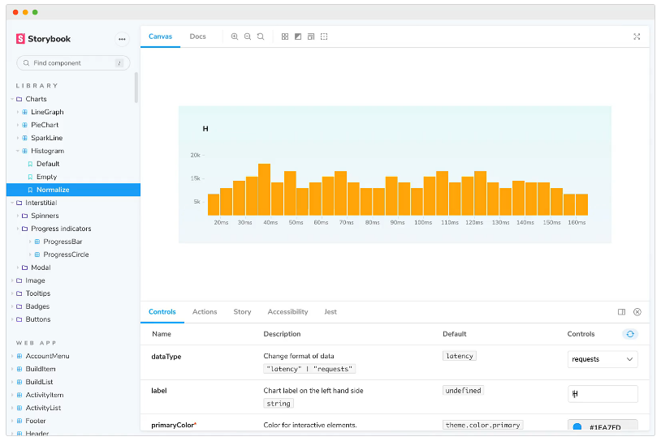
STORYBOOK.JS
Storybook is a tool for UI development. It makes development faster and easier by isolating components.
This allows you to work on one component at a time. You can develop entire UIs without needing to start up a complex dev stack, force certain data into your database, or navigate around your application.

Slide 10
